Slide 1
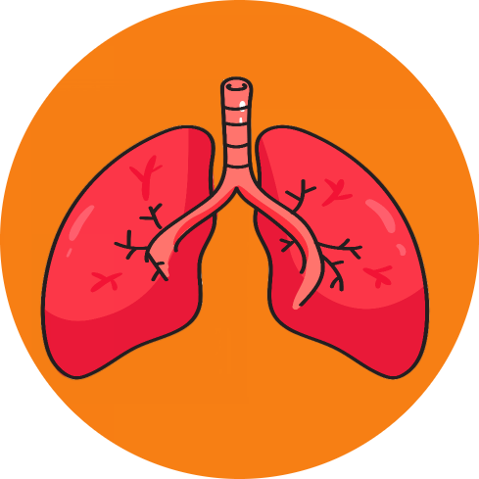
LUNGEN -BY TEAM MERAQI

Slide 2
IDEA
So the idea is to be able to predict a disease and give early warning to the user(early intervention). So that the cost of hospitalization can be reduced.

Slide 3
SOLUTION
To solve this problem, the idea is to build series of android applications which through machine learning algorithms can give prediction about the disease. Here we are building an app called ‘LUNGEN’ to predict lung cancer. We have used android studio to build the app. Google colab and pycharm to for data analysis and model learning and we have used flask and Heroku to deploy the model to android app. The dataset is taken from Kaggle.

Slide 4
THANK YOU

